Slide 1
BLM267
Chapter 14: Searching and Sorting
Data Structures Using C, Second Edition

Slide 2
Searching

Slide 3
INTRODUCTION TO SEARCHING
Searching means to find whether a particular value is present in an array or not.
If the value is present in the array, then searching is said to be successful and the searching process gives the location of that value in the array.
However, if the value is not present in the array, the searching process displays an appropriate message and in this case searching is said to be unsuccessful.
There are two popular methods for searching the array elements: linear search and binary search.
The algorithm that should be used depends entirely on how the values are organized in the array.

Slide 4
Linear Search
Linear search, also called as sequential search, is a very simple method used for searching an array for a particular value.
It works by comparing the value to be searched with every element of the array one by one in a sequence until a match is found.
Linear search is mostly used to search an unordered list of elements (array in which data elements are not sorted).
For example, if an array A[] is declared and initialized as, int A[] = {10, 8, 2, 7, 3, 4, 9, 1, 6, 5}; and the value to be searched is VAL = 7, then searching means to find whether the value ‘7’ is present in the array or not.
If yes, then it returns the position of its occurrence. Here, POS = 3 (index starting from 0).

Slide 5
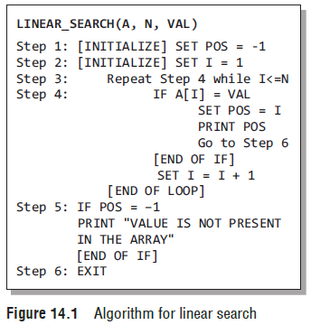
Linear Search
Figure 14.1 shows the algorithm for linear search.
In Steps 1 and 2 of the algorithm, we initialize the value of POS and I.
In Step 3, a while loop is executed that would be executed till I is less than N (total number of elements in the array).
In Step 4, a check is made to see if a match is found between the current array element and VAL.
If a match is found, then the position of the array element is printed, else the value of I is incremented to match the next element with VAL.
However, if all the array elements have been compared with VAL and no match is found, then it means that VAL is not present in the array.

Slide 6
Linear Search
Complexity of Linear Search Algorithm
Linear search executes in O(n) time where n is the number of elements in the array.
Obviously, the best case of linear search is when VAL is equal to the first element of the array.
In this case, only one comparison will be made.
Likewise, the worst case will happen when either VAL is not present in the array or it is equal to the last element of the array.
In both the cases, n comparisons will have to be made.

Slide 7
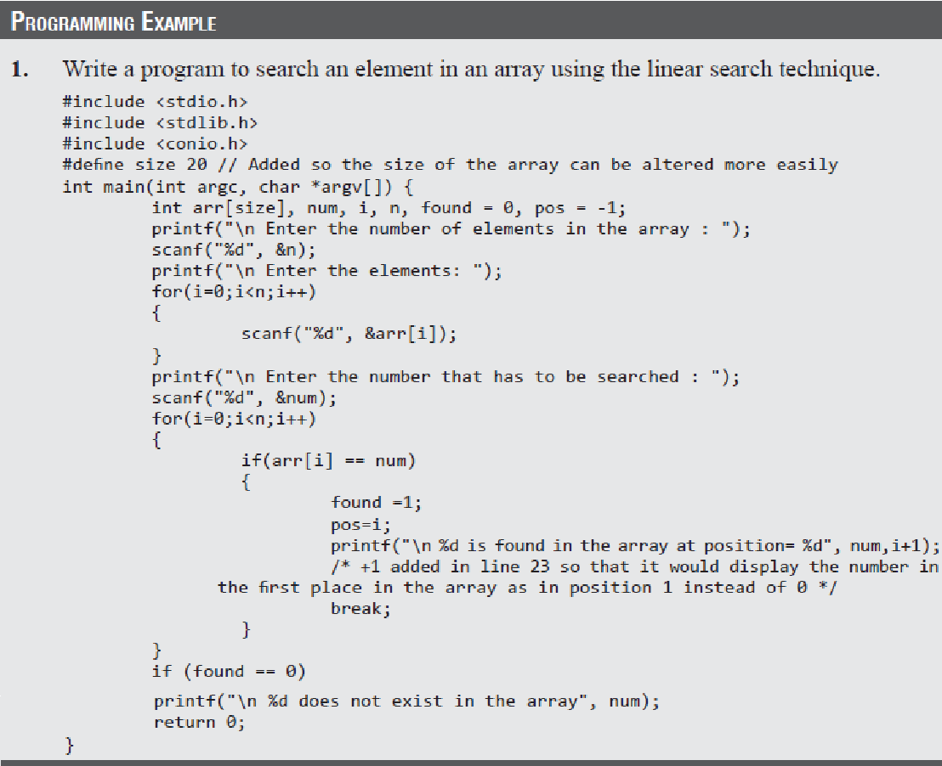
Linear Search

Slide 8
Binary Search
Binary search is a searching algorithm that works efficiently with a sorted list.
How do we find words in a dictionary? We first open the dictionary somewhere in the middle. Then, we compare the first word on that page with the desired word whose meaning we are looking for. If the desired word comes before the word on the page, we look in the first half of the dictionary, else we look in the second half. Again, we open a page in the first half of the dictionary and compare the first word on that page with the desired word and repeat the same procedure until we finally get the word.

Slide 9
Binary Search
Now, let us consider how this mechanism is applied to search for a value in a sorted array.
Consider an array A[] that is declared and initialized as
int A[] = {0, 1, 2, 3, 4, 5, 6, 7, 8, 9, 10};
and the value to be searched is VAL = 9.
The algorithm will proceed in the following manner.
BEG = 0, END = 10, MID = (0 + 10)/2 = 5
Now, VAL = 9 and A[MID] = A[5] = 5
A[5] is less than VAL, therefore, we now search for the value in the second half of the array.
So, we change the values of BEG and MID.
Now, BEG = MID + 1 = 6, END = 10, MID = (6 + 10)/2 =16/2 = 8
VAL = 9 and A[MID] = A[8] = 8
A[8] is less than VAL, therefore, we now search for the value in the second half of the segment.
So, again we change the values of BEG and MID.
Now, BEG = MID + 1 = 9, END = 10, MID = (9 + 10)/2 = 9
Now, VAL = 9 and A[MID] = 9.

Slide 10
Binary Search
In this algorithm, we see that BEG and END are the beginning and ending positions of the segment that we are looking to search for the element.
MID is calculated as (BEG + END)/2.
Initially, BEG = lower_bound and END = upper_bound.
The algorithm will terminate when A[MID] = VAL.
When the algorithm ends, we will set POS = MID.
POS is the position at which the value is present in the array.
However, if VAL is not equal to A[MID], then the values of BEG, END, and MID will be changed depending on whether VAL is smaller or greater than A[MID]. (
a) If VAL < A[MID], then VAL will be present in the left segment of the array. So, the value of END will be changed as END = MID – 1.
(b) If VAL > A[MID], then VAL will be present in the right segment of the array. So, the value of BEG will be changed as BEG = MID + 1.
Finally, if VAL is not present in the array, then eventually, END will be less than BEG. When this happens, the algorithm will terminate and the search will be unsuccessful.

Slide 11
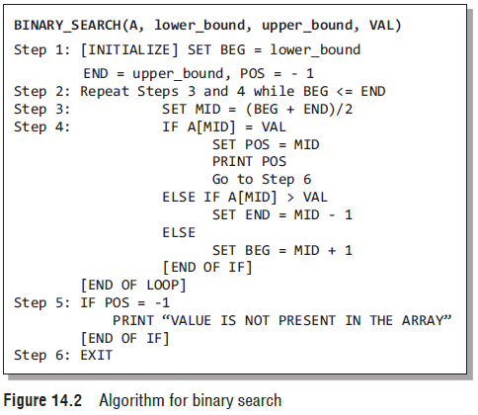
Binary Search
Figure 14.2 shows the algorithm for binary search.
In Step 1, we initialize the value of variables, BEG, END, and POS.
In Step 2, a while loop is executed until BEG is less than or equal to END.
In Step 3, the value of MID is calculated.
In Step 4, we check if the array value at MID is equal to VAL (item to be searched in the array).
If a match is found, then the value of POS is printed and the algorithm exits.
However, if a match is not found, and if the value of A[MID] is greater than VAL, the value of END is modified, otherwise if A[MID] is greater than VAL, then the value of BEG is altered.
In Step 5, if the value of POS = –1, then VAL is not present in the array and an appropriate message is printed on the screen before the algorithm exits.

Slide 12
Binary Search
Complexity of Binary Search Algorithm
The complexity of the binary search algorithm can be expressed as f(n), where n is the number of elements in the array.
The complexity of the algorithm is calculated depending on the number of comparisons that are made.
In the binary search algorithm, we see that with each comparison, the size of the segment where search has to be made is reduced to half.
Thus, we can say that, in order to locate a particular value in the array, the total number of comparisons that will be made is given as
2^{f(n)} > n or f(n) = log₂n

Slide 13
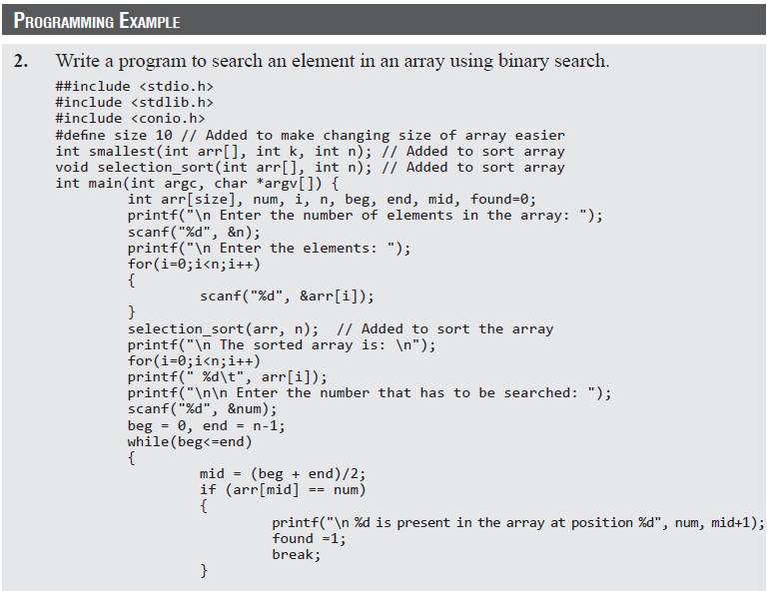
Binary Search

Slide 14
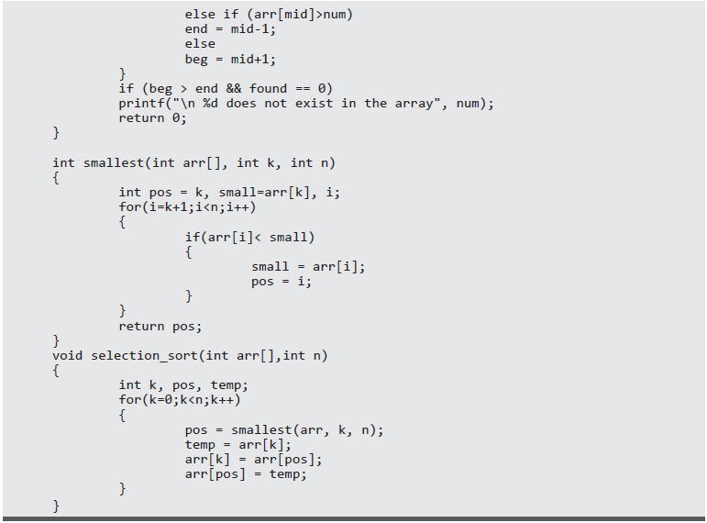
Binary Search

Slide 15
Interpolation Search
Interpolation search, also known as extrapolation search, is a searching technique that finds a specified value in a sorted array.
The concept of interpolation search is similar to how we search for names in a telephone book or for keys by which a book’s entries are ordered.
For example, when looking for a name “Bharat” in a telephone directory, we know that it will be near the extreme left, so applying a binary search technique by dividing the list in two halves each time is not a good idea.
We must start scanning the extreme left in the first pass itself.
In each step of interpolation search, the remaining search space for the value to be found is calculated.
The calculation is done based on the values at the bounds of the search space and the value to be searched.
The value found at this estimated position is then compared with the value being searched for.
If the two values are equal, then the search is complete.

Slide 16
Interpolation Search
However, in case the values are not equal then depending on the comparison, the remaining search space is reduced to the part before or after the estimated position.
Thus, we see that interpolation search is similar to the binary search technique.
However, the important difference between the two techniques is that binary search always selects the middle value of the remaining search space. It discards half of the values based on the comparison between the value found at the estimated position and the value to be searched.
But in interpolation search, interpolation is used to find an item near the one being searched for.

Slide 17
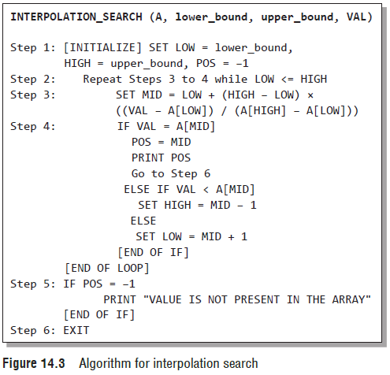
Interpolation Search
The algorithm for interpolation search is given in Fig. 14.3.

Slide 18
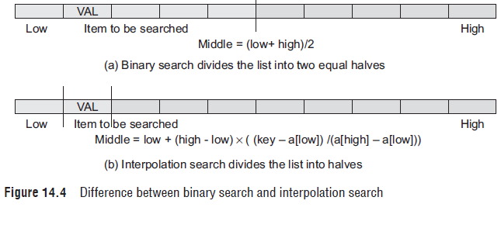
Interpolation Search
Figure 14.4 helps us to visualize how the search space is divided in case of binary search and interpolation search.

Slide 19
Interpolation Search
Complexity of Interpolation Search Algorithm
When n elements of a list to be sorted are uniformly distributed (average case), interpolation search makes about log(log n) comparisons.
However, in the worst case, that is when the elements increase exponentially, the algorithm can make up to O(n) comparisons.

Slide 20
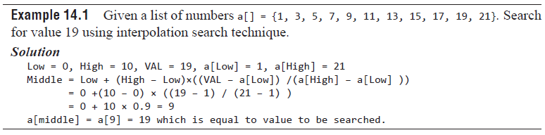
Interpolation Search

Slide 21
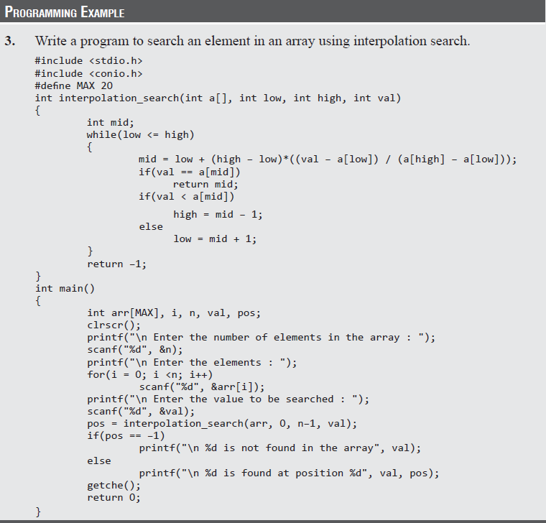
Interpolation Search

Slide 22
Jump Search
When we have an already sorted list, then the other efficient algorithm to search for a value is jump search or block search.
In jump search, it is not necessary to scan all the elements in the list to find the desired value.
We just check an element and if it is less than the desired value, then some of the elements following it are skipped by jumping ahead.
After moving a little forward again, the element is checked.
If the checked element is greater than the desired value, then we have a boundary and we are sure that the desired value lies between the previously checked element and the currently checked element.
However, if the checked element is less than the value being searched for, then we again make a small jump and repeat the process.
Once the boundary of the value is determined, a linear search is done to find the value and its position in the array.

Slide 23
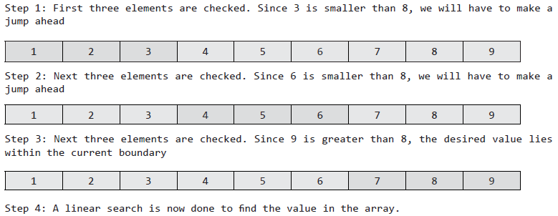
Jump Search
For example, consider an array
a[] = {1,2,3,4,5,6,7,8,9}.
The length of the array is 9.
If we have to find value 8 then following steps are performed using the jump search technique.

Slide 24
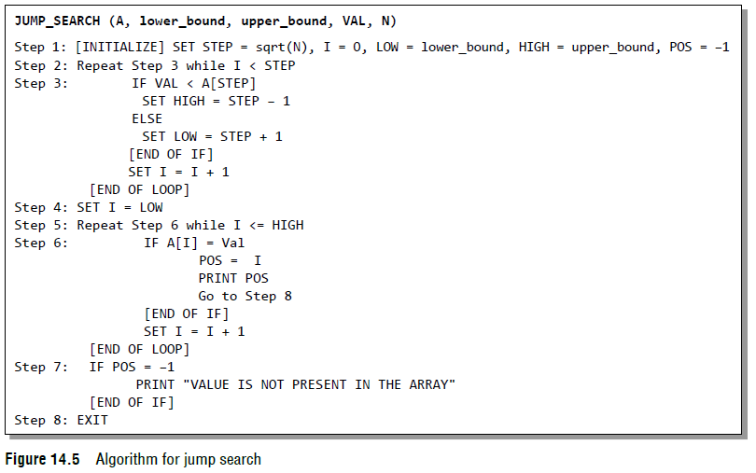
Jump Search
The algorithm for jump search is given in Fig. 14.5.

Slide 25
Jump Search
Advantage of Jump Search over Linear Search
Suppose we have a sorted list of 1000 elements where the elements have values 0, 1, 2, 3, 4, …, 999, then sequential search will find the value 674 in exactly 674 iterations.
But with jump search, the same value can be found in 44 iterations. Hence, jump search performs far better than a linear search on a sorted list of elements.
Advantage of Jump Search over Binary Search
No doubt, binary search is very easy to implement and has a complexity of O(log n), but in case of a list having very large number of elements, jumping to the middle of the list to make comparisons is not a good idea because if the value being searched is at the beginning of the list then one (or even more) large step(s) in the backward direction would have to be taken.
In such cases, jump search performs better as we have to move little backward that too only once. Hence, when jumping back is slower than jumping forward, the jump search algorithm always performs better.

Slide 26
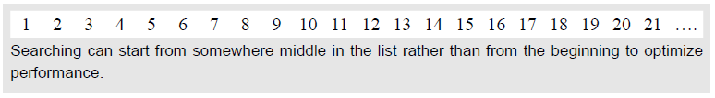
Jump Search
How to Choose the Step Length?
For the jump search algorithm to work efficiently, we must define a fixed size for the step.
If the step size is 1, then algorithm is same as linear search.
Now, in order to find an appropriate step size, we must first try to figure out the relation between the size of the list (n) and the size of the step (k). Usually, k is calculated as √n.
Further Optimization of Jump Search
Till now, we were dealing with lists having small number of elements. But in real-world applications, lists can be very large. In such large lists searching the value from the beginning of the list may not be a good idea.
A better option is to start the search from the k–th element as shown in the figure below.

Slide 27
Jump Search
We can also improve the performance of jump search algorithm by repeatedly applying jump search.
For example, if the size of the list is 1000000 (n).
The jump interval would then be
√n =√1000000 =1000.
Now, even the identified interval has 1000 elements and is again a large list. So, jump search can be applied again with a new step size of
√1000 ≈ 31.
Thus, every time we have a desired interval with a large number of values, the jump search algorithm can be applied again but with a smaller step.
However, in this case, the complexity of the algorithm will no longer be O(√n) but will approach a logarithmic value.

Slide 28
Jump Search
Complexity of Jump Search Algorithm
Jump search works by jumping through the array with a step size (optimally chosen to be √n) to find the interval of the value.
Once this interval is identified, the value is searched using the linear search technique.
Therefore, the complexity of the jump search algorithm can be given as O(√n).

